Slide 1
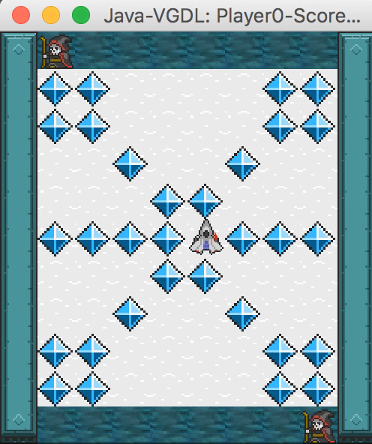
CE810 / IGGI Game Design II General Video Game AI
Diego Perez-Liebana

Slide 2
Contents
The General Video Game AI Framework and Competition
2-Player GVGAI
Parameterizing GVGAI
Today’s exercise

Slide 3
The General Video Game AI Framework and Competition

Slide 4
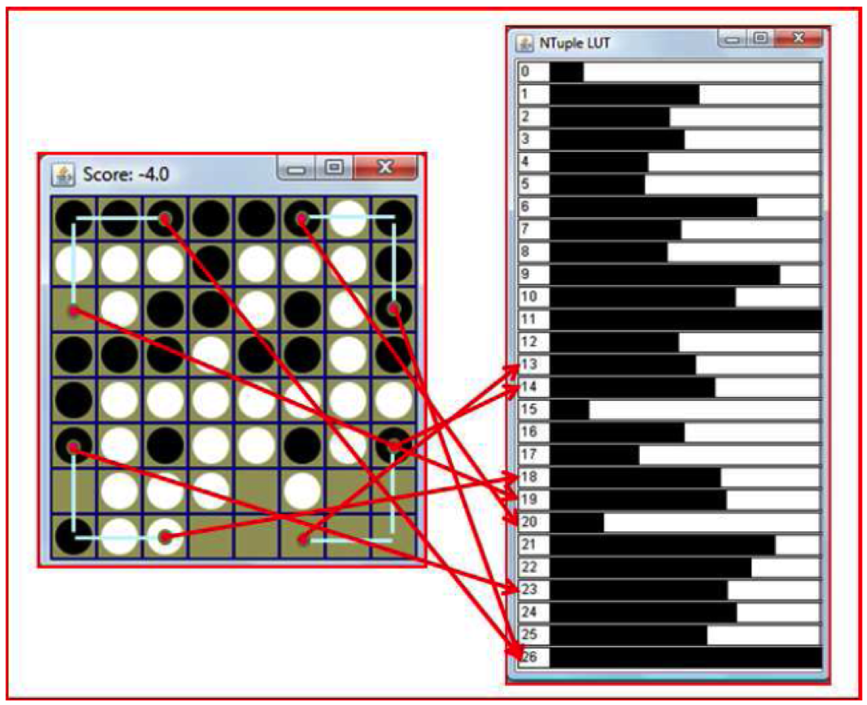

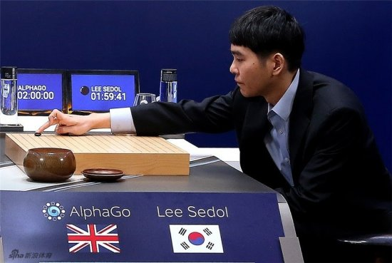
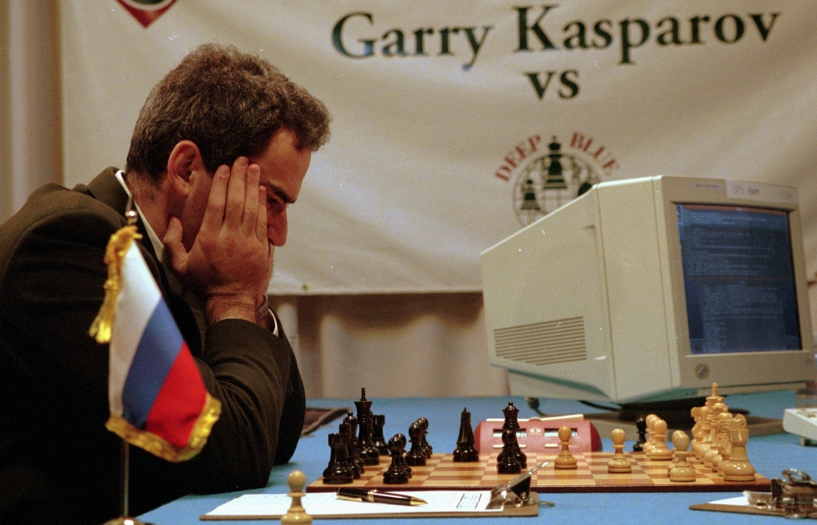
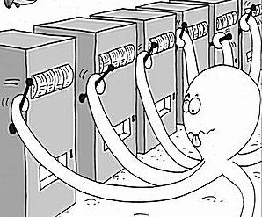
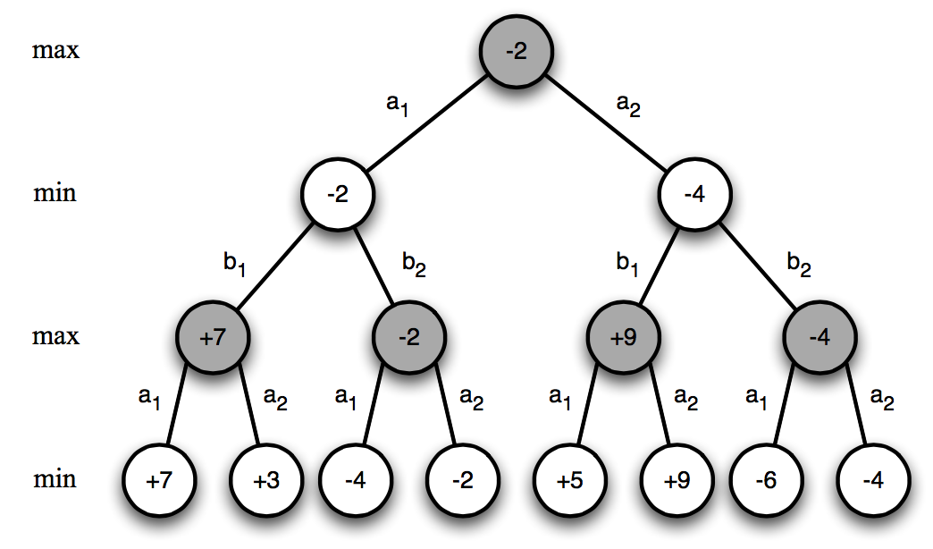
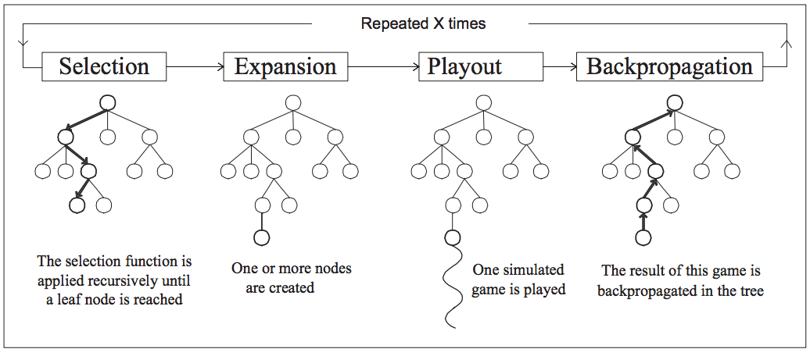
AI Research in Games
Games: Benchmarks for AI

Slide 5
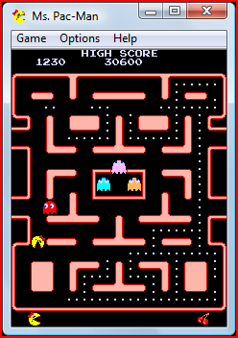
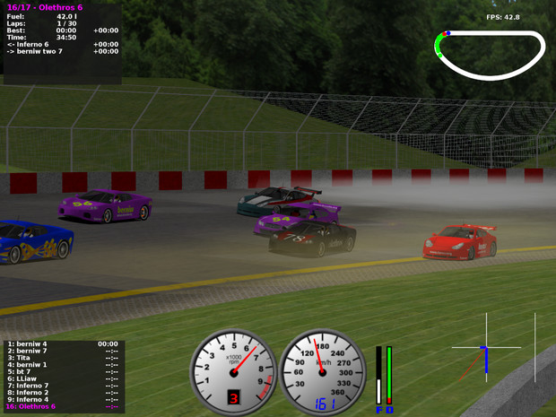
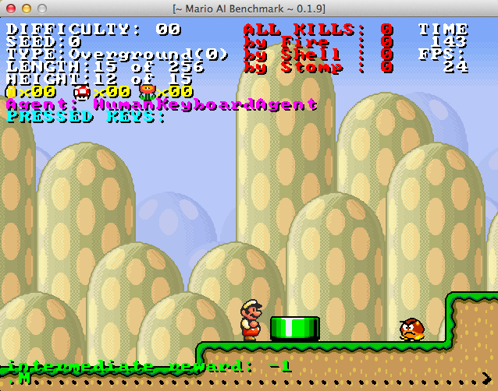

General Video Game Playing
Video game-based AI Competitions

Slide 6
General Video Game Playing
General Video Game Playing?

Slide 7

General Video Game Playing
Creating agents that can play any (board) game
First AIII GGP Competition, by the Stanford University Logic Group [Genesereth and Love, 2005]
At least 1s decision time

Slide 8
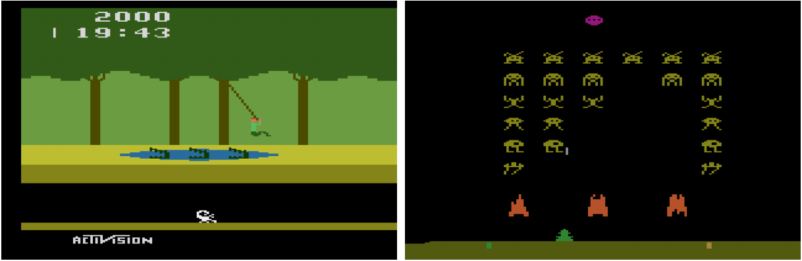
General Video Game Playing
Creating agents that can play any (real-time, arcade) game (milliseconds of decision time)
Evaluation of AI agents in domain-independent environments
Arcade Learning Environment (ALE), [Bellemare et al., 2013]: Evaluation of AI agents in 55 games of the Atari 2600 Collection
Human-level control through deep reinforcement learning [Mnih et al., 2015]

Slide 9
General Video Game Playing
Levine et al. propose the creation of a new benchmark for GVGP [Levine et al., 2013]
Compliments ALE in two ways:
Creation of games in a more general framework.
No screen capture analysis needed, information via encapsulated objects.
Video Game Description Language (VGDL) [Tom Schaul, 2013]
Benchmark for learning and planning problems.
Base for the GVGAI Framework

Slide 10
VGDL and the GVGAI Framework
A competition where competitors submit game-playing agents
Agents are tested on unseen videogames
Games are implemented in the Video Game Description Language
Notes:
Diego IN

Slide 11
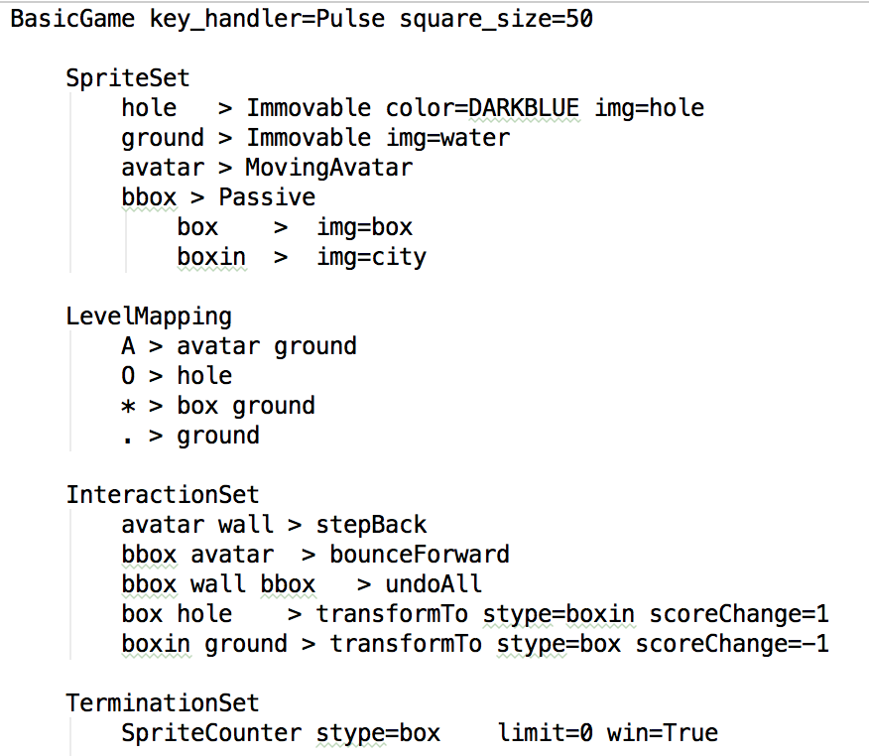
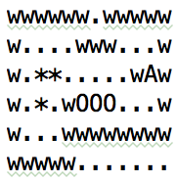
VGDL and the GVGAI Framework
(Sokoban)
https://github.com/EssexUniversityMCTS/gvgai/wiki/VGDL-Language

Slide 12
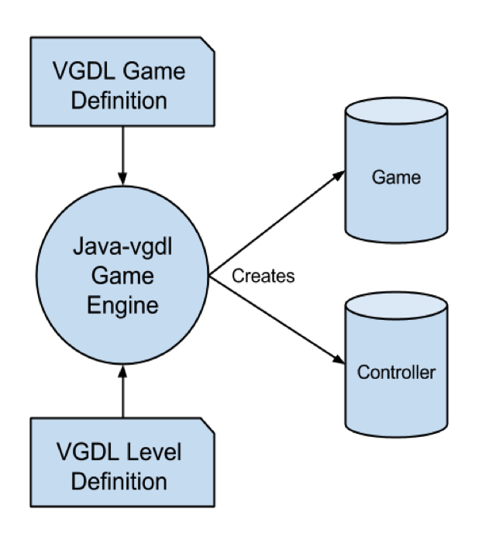
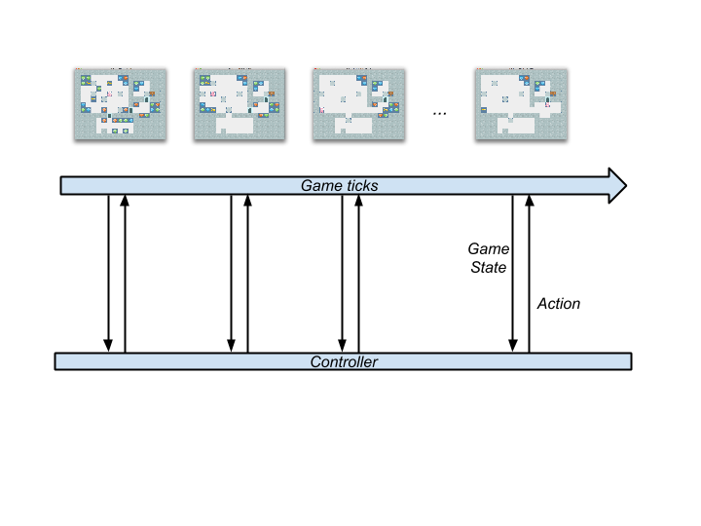
VGDL and the GVGAI Framework
The GVGAI Framework
40 ms as budget time per action.
If returns action between 40 and 50ms, NIL is applied.
If returns action after 50ms, the agent is disqualified and loses the game.

Slide 13
How GVGAI differs…
From General Game Playing:
We do videogames! Real-time constraints!
We don’t make the ruleset available
Notes:
Julian IN

Slide 14
How GVGAI differs…
From the Arcade Learning Environment (ALE):
Structured API (information via Java objects)
Potentially infinite supply of games
Agents tested on unseen games

Slide 15
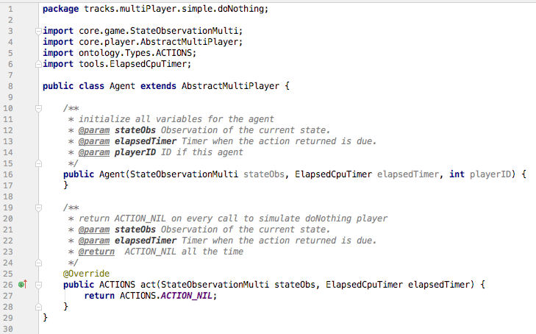
VGDL and the GVGAI Framework
It is very simple to write your first controller!

Slide 16
VGDL and the GVGAI Framework
Every time step, agents receive information:
State of the game:
Score, tick, winner, game over, world dimensions.
State of the avatar:
Position, speed, orientation, resources.
Available actions.
History of events (collisions) in the game.
Other sprites:
Observation grid.
Categorized observations (NPC, Portal, static sprites…)

Slide 17
VGDL and the GVGAI Framework
Every time step, agents can use a forward model:
copy()
advance(action)
Advances the state applying the action supplied
Allows to simulate the effects of applying actions
The games are stochastic in nature!
Next state is just a possible future state when applying an action.
Agent is responsible for dealing with these inaccuracies.

Slide 18
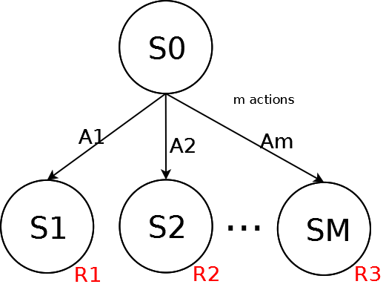
VGDL and the GVGAI Framework
Framework provides sample controllers:
Simple One Step Look Ahead:

Slide 19
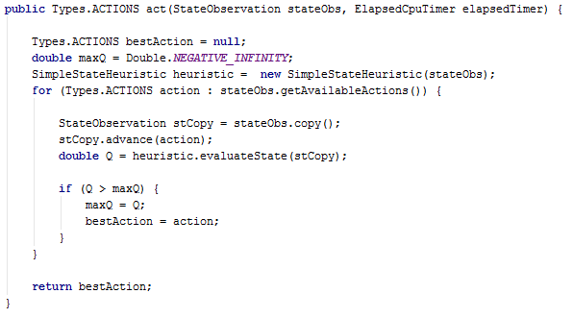
VGDL and the GVGAI Framework
Simple One Step Look Ahead:

Slide 20
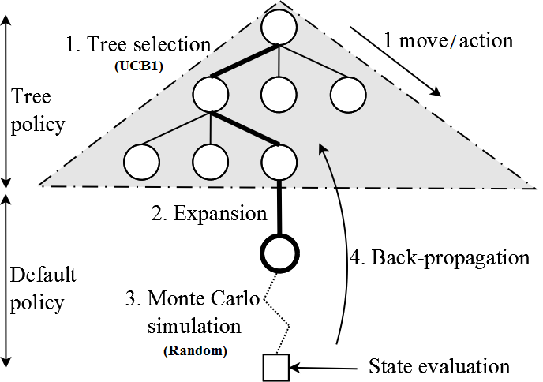
VGDL and the GVGAI Framework
Monte Carlo Tree Search (Open and Close loop)

Slide 21
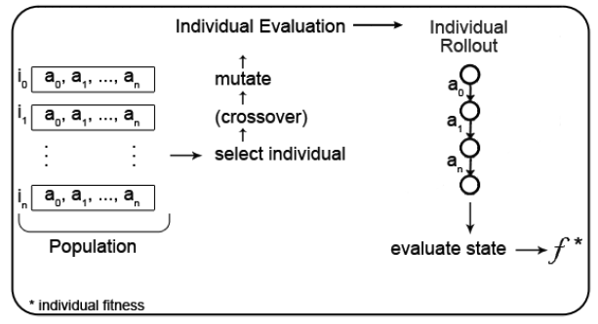
VGDL and the GVGAI Framework
Rolling Horizon Evolutionary Algorithms (RHEA)
Individual: sequence of actions to apply from the current state (open loop)
Fitness: evaluation of the state reached after applying actions
RHEA evolves the best sequence of actions in a time step
When time is up, apply first action of best individual

Slide 22
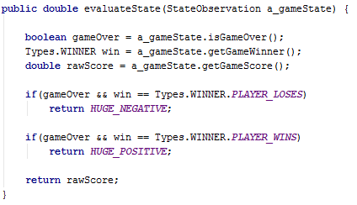
VGDL and the GVGAI Framework
Simple One Step Look Ahead:

Slide 23
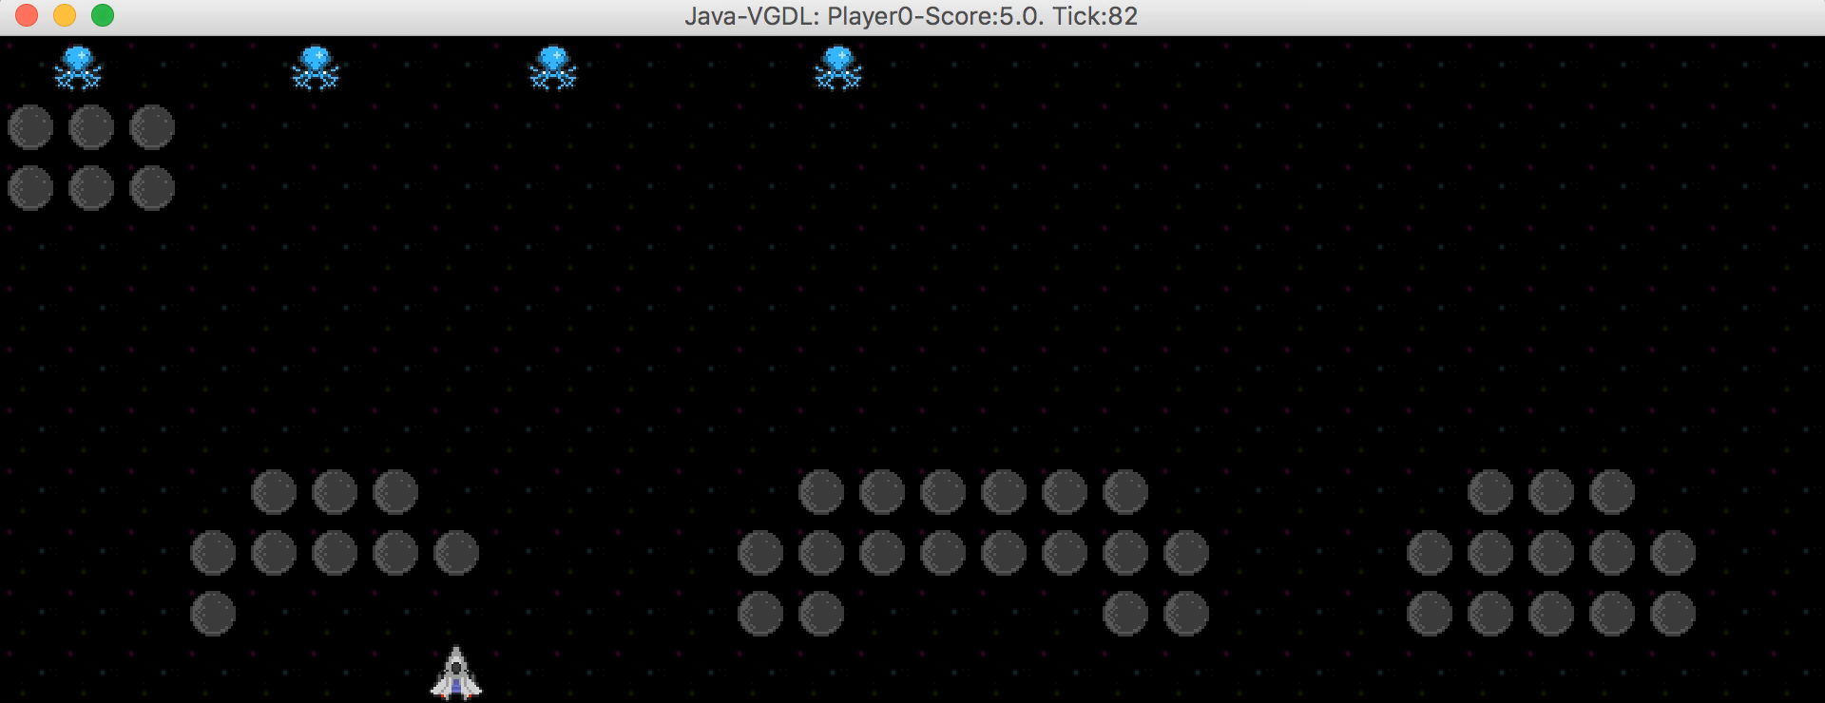
VGDL and the GVGAI Framework
Current set of 80 games (60 of them public)
(Aliens)

Slide 24
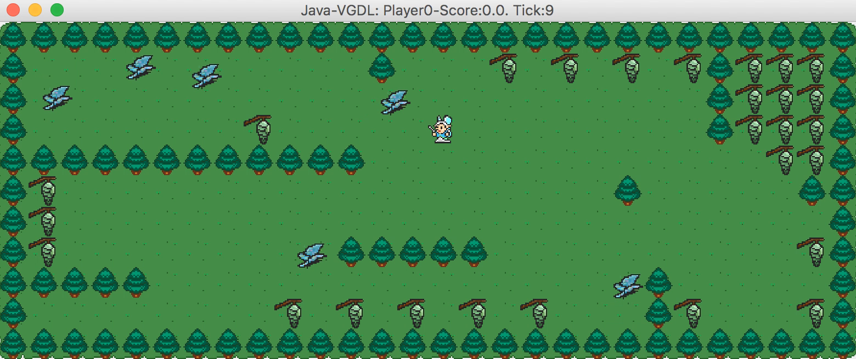
VGDL and the GVGAI Framework
(Butterflies)

Slide 25
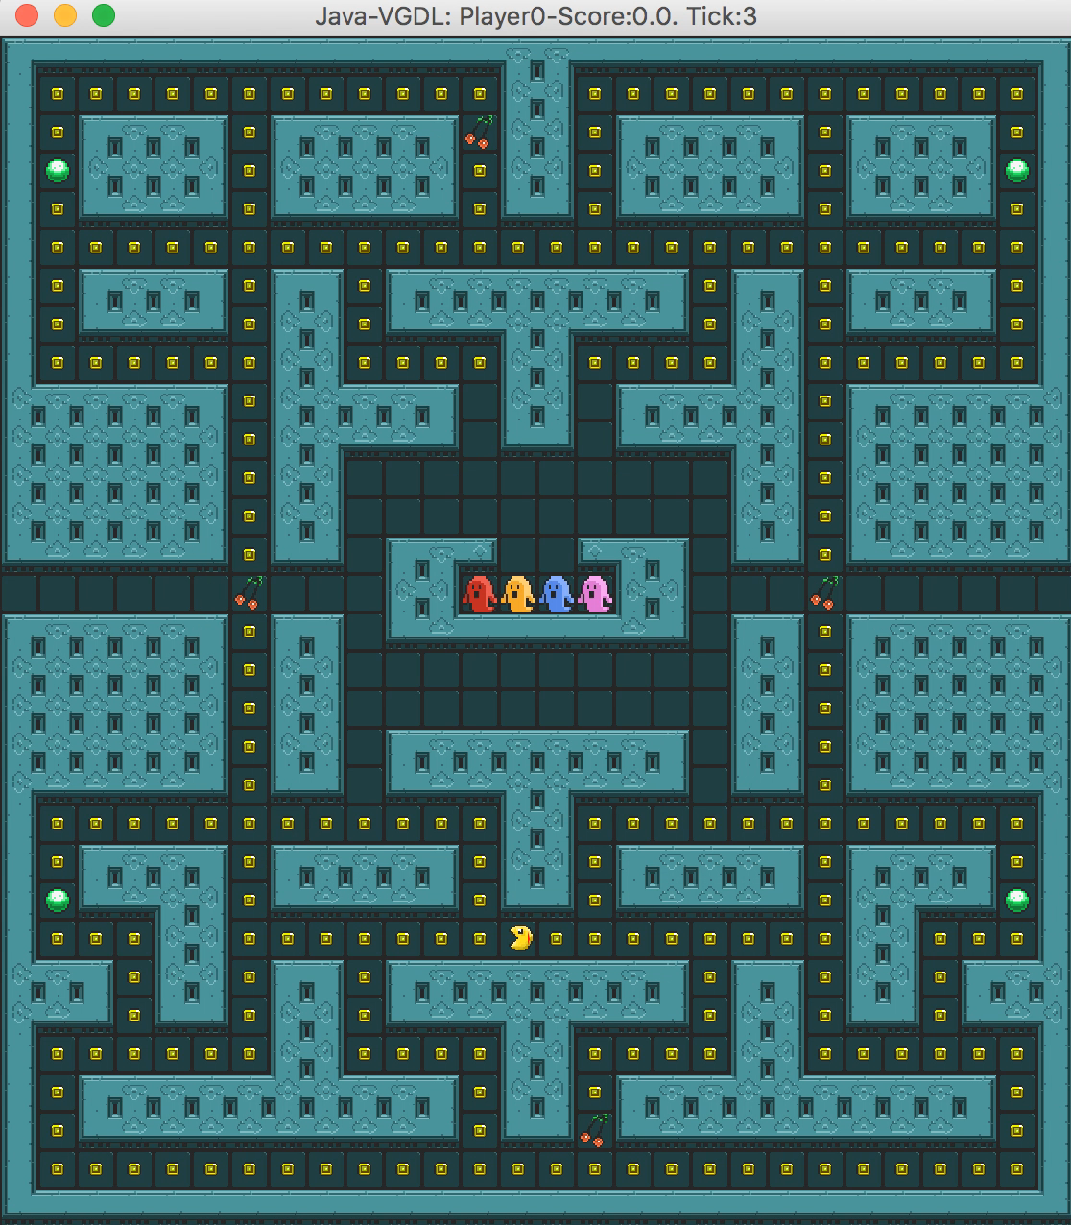
VGDL and the GVGAI Framework
(Pac Man)

Slide 26
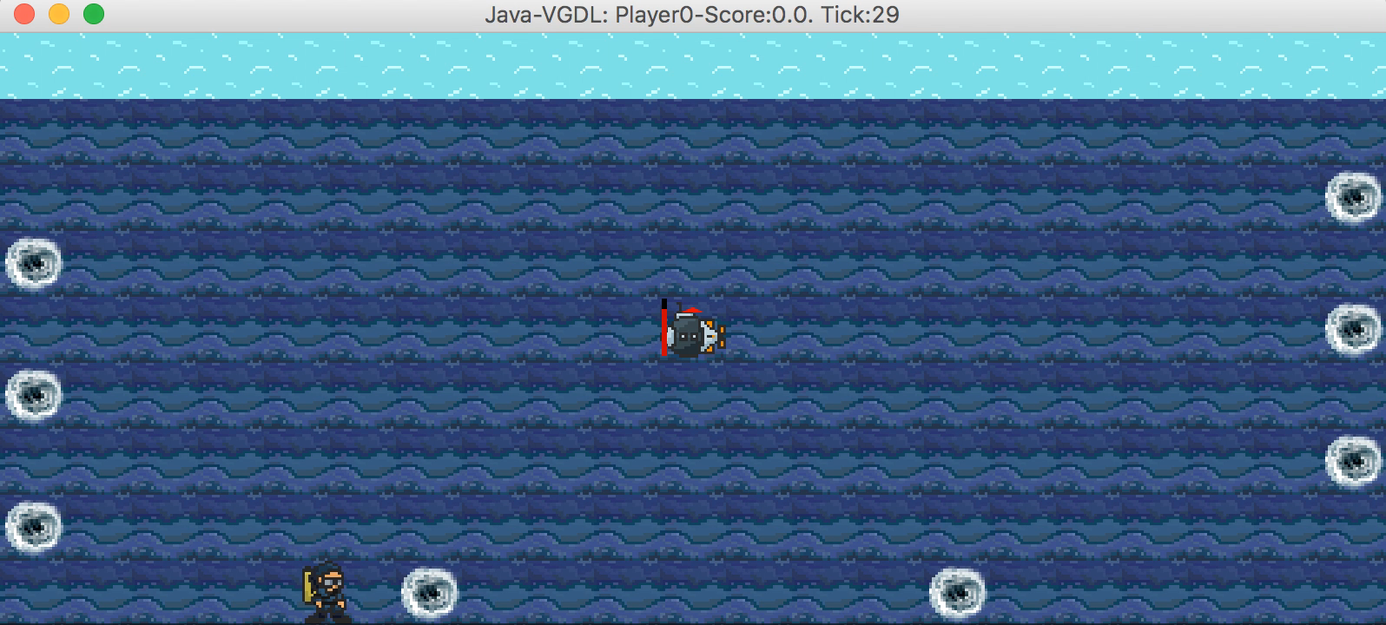
VGDL and the GVGAI Framework
(Sequest)

Slide 27
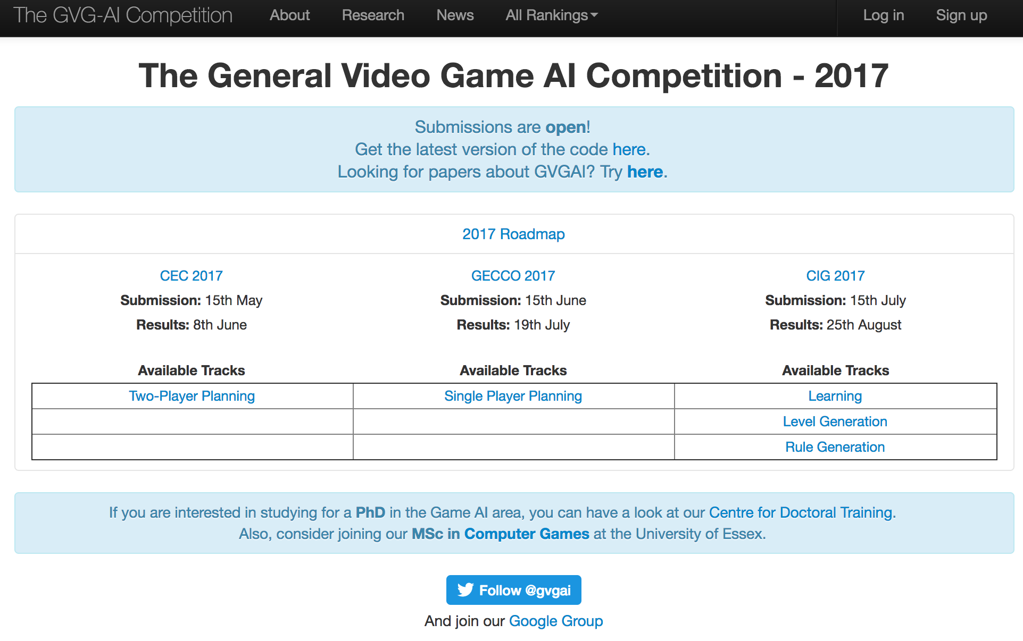
The GVGAI Competition – www.gvgai.net
Competition Structure:
3 Game Sets, 10 games each, 5 levels per game.
Training Set: 10 games distributed with the framework.
Validation Set: 10 games, unknown to the participants.
Test Set: 10 games, unknown, and only executed in once.

Slide 28
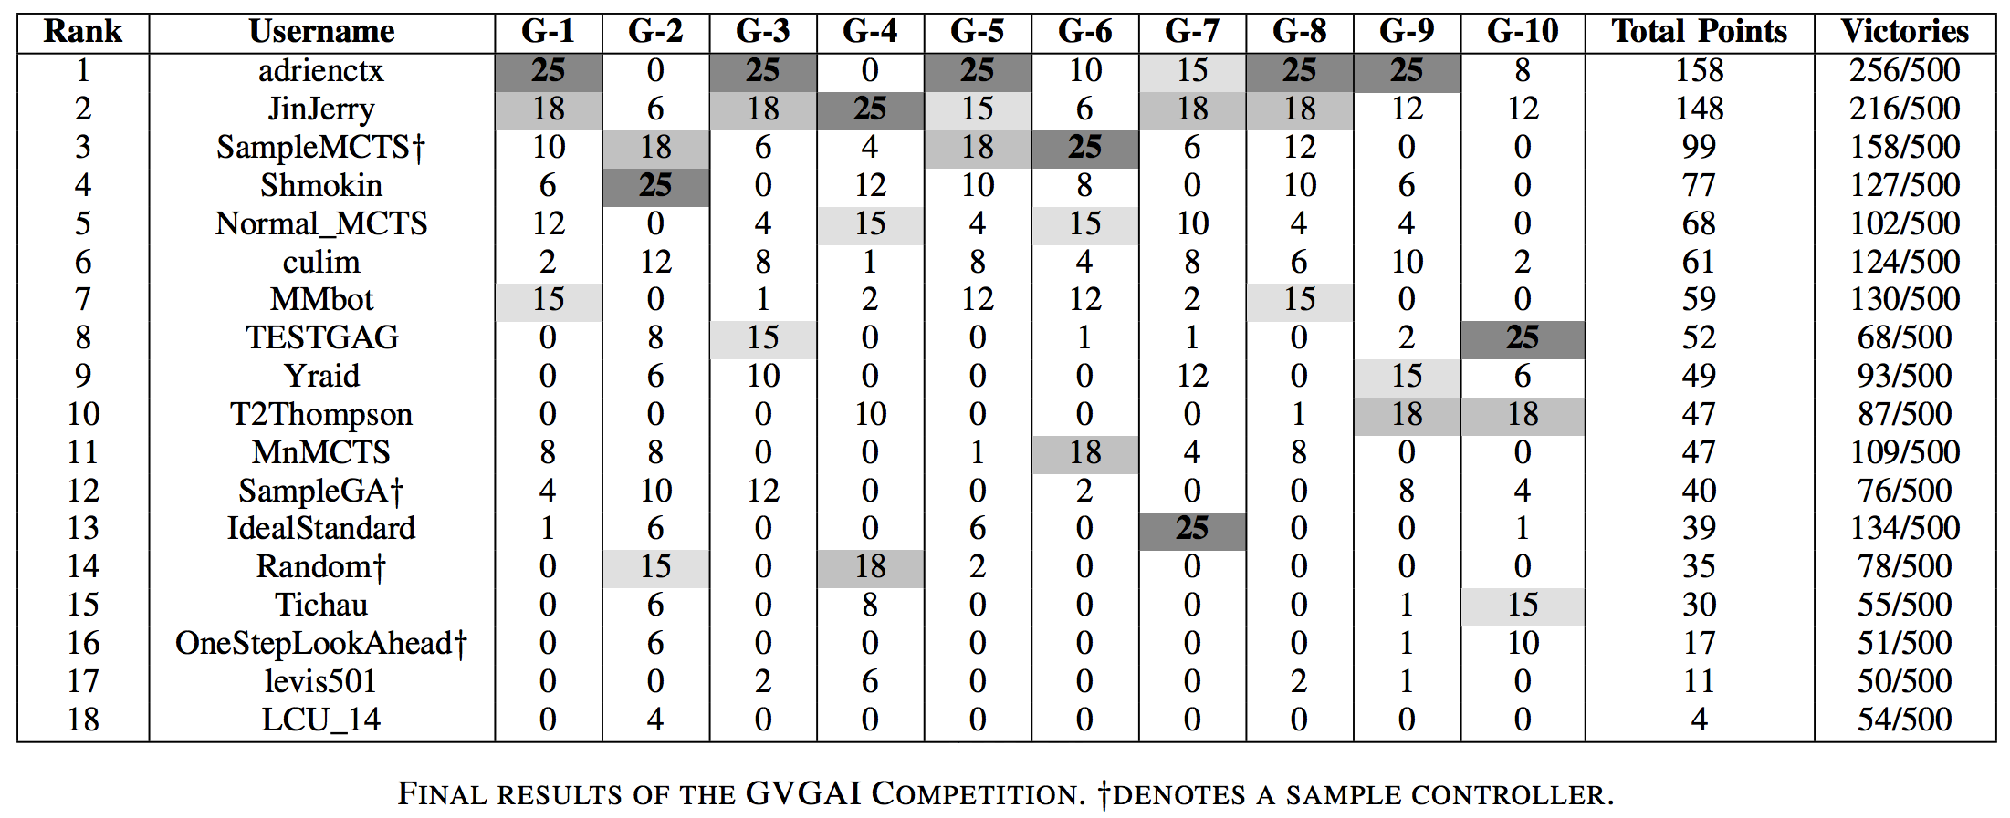
The GVGAI Competition – www.gvgai.net
IEEE CIG 2014 Competition results:
Winner: Adrien Couëtoux (51.2%) [Perez et al., 2015]

Slide 29
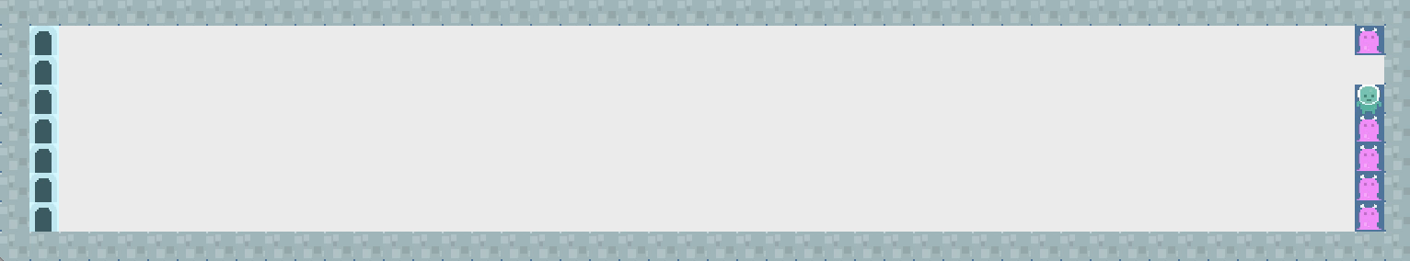
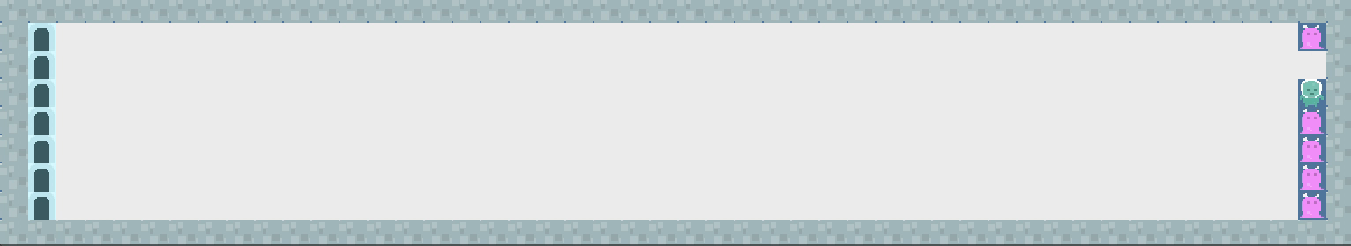
The GVGAI Competition – www.gvgai.net
adrienctx– 1st Position
IdealStandard – 13th Position

Slide 30
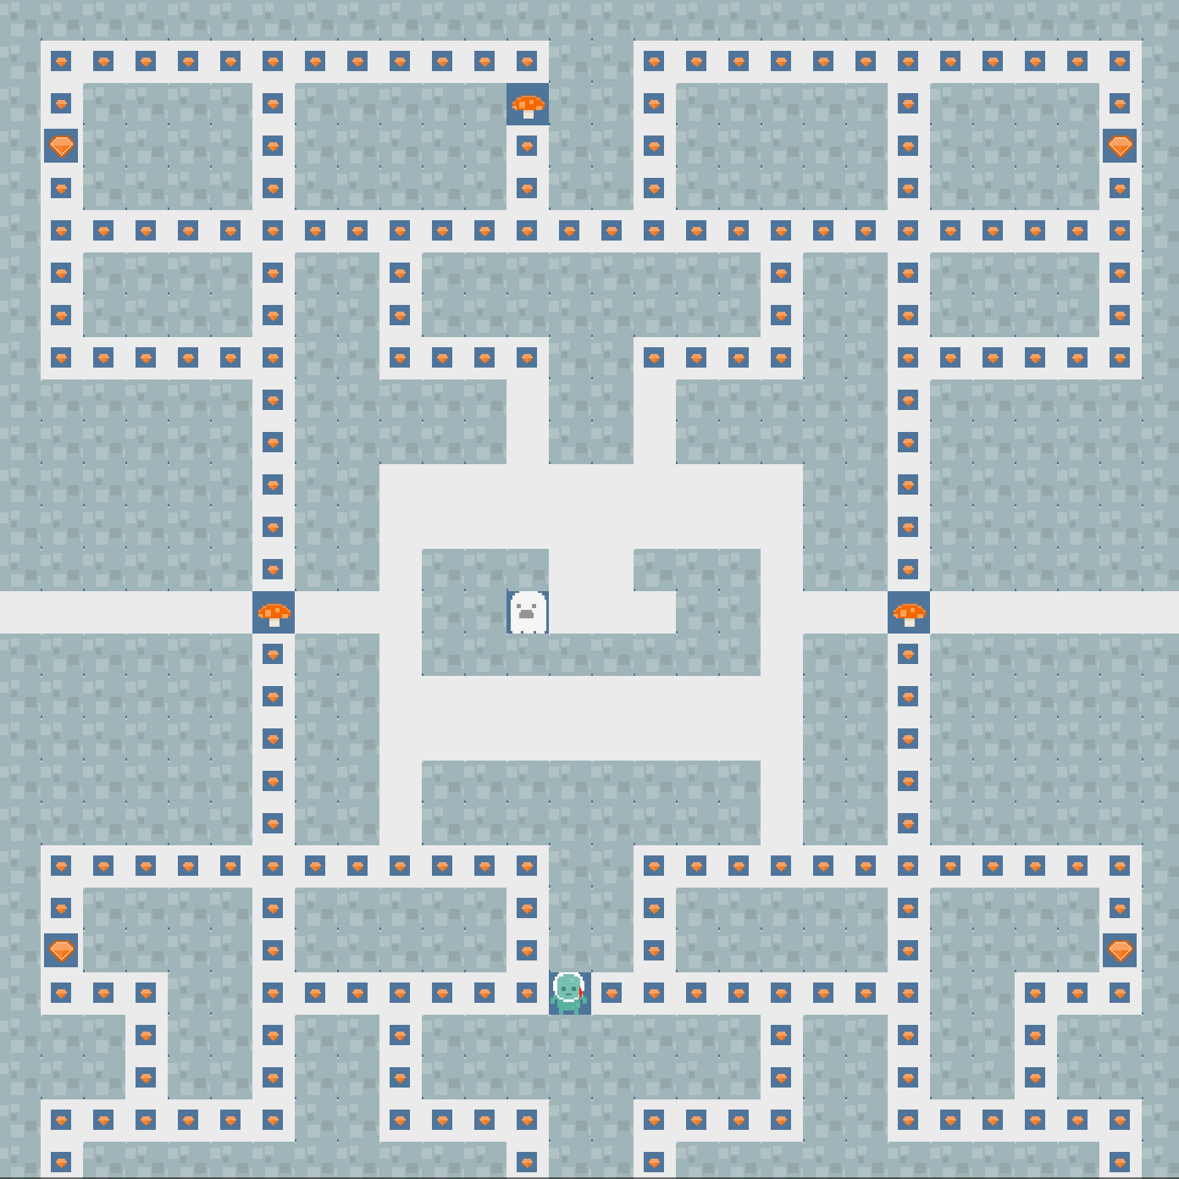
IdealStandard – 13th Position

Slide 31

adrienctx– 1st Position

Slide 32
The GVGAI Competition – www.gvgai.net
GVGAI 2015 Competition:
ACM GECCO (July 2015)
Winner: YOLOBOT (63.8%; MCTS, BFS, Sprite Targeting Heuristic)
IEEE CIG (August 2015)
Winner: Return42 (35.8%; GA w/ heuristic, random walks, A*)
IEEE CEEC (September 2015)
Winner: YBCriber (39.2%; Iterative Widening, Danger Avoidance)
GVGAI 2016 Competition:
IEEE CIG (September 2016)
Single-Player Winner: YOLOBOT (41.6%)
Two-Player Winner: adrienctx (271 points)
IJCAI (July 2016)
Level Generation Winner: easablade (35% preferred)

Slide 33
The GVGAI Competition – www.gvgai.net
GVGAI 2017 Competition: 5 tracks!
Single Player Planning Track:
GECCO 2017 – Berlin (Germany), July 15th – 19th
Two-Player Planning Track:
CEC 2017 – San Sebastián (Spain), June 5th – 8th
Learning Track:
CIG 2017 – New York (USA), August 22nd – 25th
Level Generation Track; and
Rule Generation Track:
ICCC 2017 – Atlanta (USA), June 19th – 23rd

Slide 34
2-Player GVGAI

Slide 35
The 2-Player GVGAI Planning Track
2 players compete (or cooperate) in real-time games of simultaneous moves.
40 training games, all play versus all, or using Glicko2 pairing system.
10 validation (and 10 test extra games).
Separated interface for 2 (N) player game agents.

Slide 36
The 2-Player GVGAI Planning Track
40 Games: accelerator, akkaarrh, asteroids, beekeeper, bombergirl, breedingdragons, captureflag, competesokoban, copsNrobbers, donkeykong, dragonattack, drowning, egghunt, fatty, firetruck, football, ghostbusters, gotcha, isawsanta, klax, mimic, minesweeper, minions, oopsbrokeit, reflection, rivalry, romeoNjuliet, samaritan, sokoban, steeplechase, teamescape, thebridge, trainride, treasuremap, tron, upgrade-x, uphigh, warzone, watchout and wheelme.
5 levels per game
Descriptions
Set 1: http://www.gvgai.net/training_set.php?rg=2001
Set 2: http://www.gvgai.net/training_set.php?rg=2002
etc…

Slide 37

2-Player VGDL
VGDL
Game definition (first line)
Keywork BasicGame
Parameters:
no_players=N (default: 1).
square_size=N
key_handler={Pulse, Input} (default: Input).
Example (Akka Arrh):

Slide 38
2-Player VGDL
VGDL
Sprite Set: defines the sprites that can appear in the game.
Sprite name
Sprite type (defined in the ontology – Java class):
Immovable, Portal, Resource, MovingAvatar, RandomNPC, …
Each type allows certain parameters:
Common: singleton, img, speed, invisible, hidden, …
Specific: stype, limit, cons, …
Allows nested definitions

Slide 39
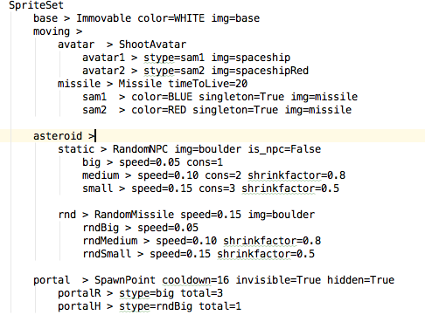
2-Player VGDL
VGDL (Asteroids SpriteSet):

Slide 40
2-Player VGDL
VGDL
Interaction Set: defines the interactions that can occur in the game.
Two sprite names
(Or more: contracted interactions)
Effect name (defined in the ontology – Java class)
Each effect allows certain parameters:
Common: scoreChange, repeat, enabled
Specific: stype, pixelPerfect
Effects are executed sequentially every tick.

Slide 41
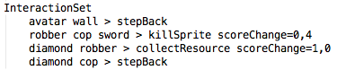
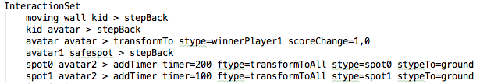
2-Player VGDL
VGDL (CropsNRobbers and Gotcha InteractionSet):

Slide 42
2-Player VGDL
VGDL
Termination Set: determines the conditions that finish the game and winner(s).
Termination type:
Timeout, TimeoutScoreCount,SpriteCounter, MultiSpriteCounter
Parameters: stype, limit, win, scoreCount
Allows multiple conditions.
Checked in sequence.
Default engine ending: (all) lose after 2000 ticks.
Check core.competition.CompetitionParameters.java: MAX_TIMESTEPS variable

Slide 43
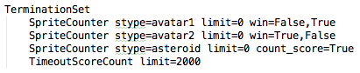
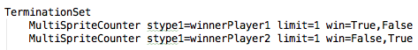
2-Player VGDL
VGDL (Asteroids and Steeplechase TerminationSet):

Slide 44
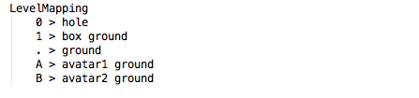
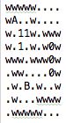
2-Player VGDL
VGDL
Level Mapping: maps characters to sprite types
Upper case letters reserved for avatars
One character can map to N sprites.
Sokoban level mapping and level:

Slide 45
2-Player Agents
Agents:
Agent.java
Inherits from AbstractMultiPlayer.java
Constructor:
StateObservationMulti
ElapsedCpuTimer (1s)
PlayerID (0 .. 1)
Act: StateObservationMulti and ElapsedCpuTimer (40ms)
Documentation: https://github.com/EssexUniversityMCTS/gvgai/wiki/Creating-Multi-Player-Controllers
Search for them in: tracks.multiPlayer.*

Slide 46
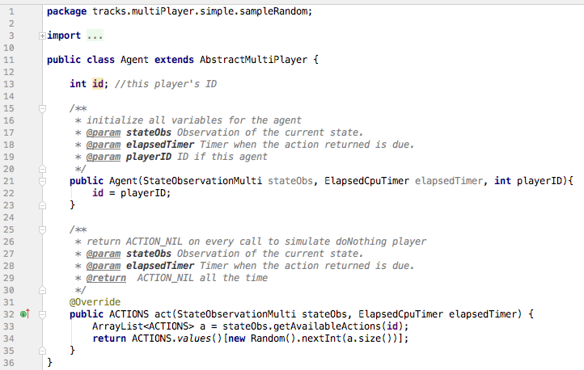
2-Player Agents
Sample Random Controller:

Slide 47
2-Player Agents
What do the agents see?
State of the game:
Game tick, game over, world dimensions.
https://github.com/EssexUniversityMCTS/gvgai/wiki/Querying-the-state-of-the-game-(2-Player)
State of the avatar:
Position, speed, orientation, resources.
Score and winner
All by player ID
https://github.com/EssexUniversityMCTS/gvgai/wiki/Information-about-the-state-of-the-Avatars-(2-Player)
Available actions, by player ID
History of events (collisions) in the game.
Other sprites:
Observation grid.
Categorized observations (NPC, Portal, static sprites…)

Slide 48
2-Player Agents
How do the agents act?
2-Player games have simultaneous moves.
Forward model:
copy()
advance(Types.ACTIONS[] actions)
array of actions for all players in the game,
index in the array corresponding to playerID.
Sample controllers:
src/tracks/multiPlayer/simple: doNothing, random, oneStepLookAhead
src/tracks/multiPlayer/advanced: MCTS, RHEA, RandomSearch

Slide 49
Parameterizing GVGAI

Slide 50
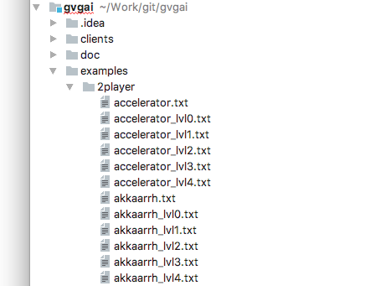
Parameterizing GVGAI
All games and levels are in:
examples/2player/

Slide 51
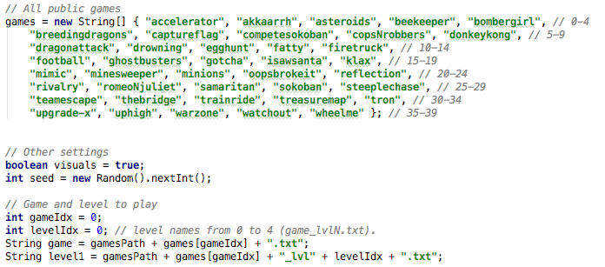
Parameterizing GVGAI
You can play them in:
tracks.multiPlayer.TestMultiPlayer.java

Slide 52
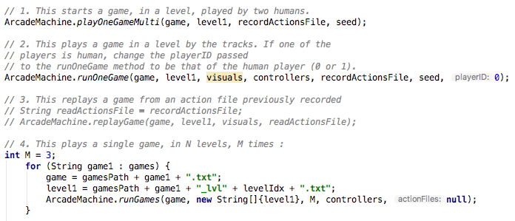
Parameterizing GVGAI
You can play them in (II)
tracks.multiPlayer.TestMultiPlayer.java

Slide 53
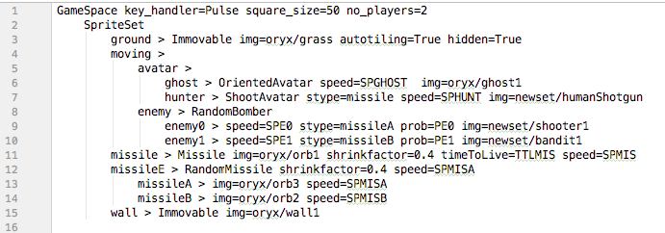
Parameterizing GVGAI
examples/gameDesign/ has version of these games that are parameterizables
SpriteSet of examples/gameDesign/ghostbusters.txt

Slide 54
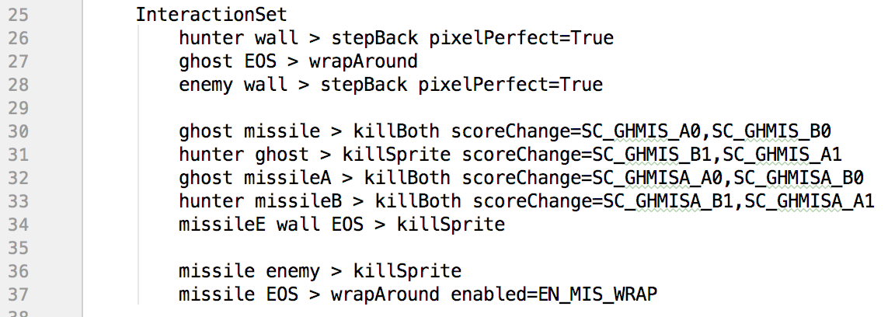
Parameterizing GVGAI
The InteractionSet can be also parameterized:

Slide 55
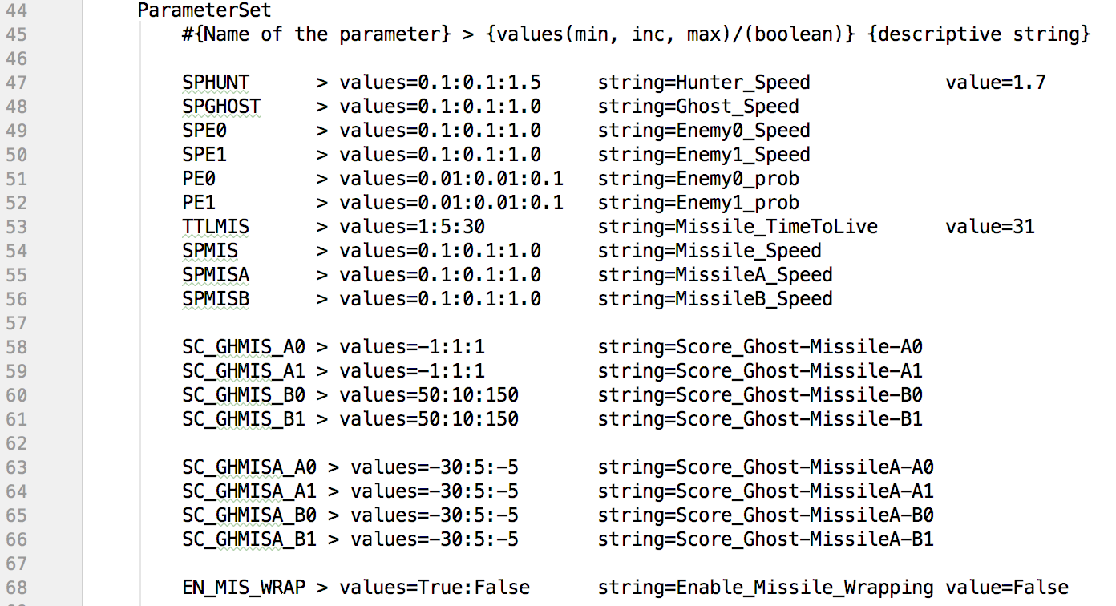
Parameterizing GVGAI
Parameters are defined in a new Set:

Slide 56



Parameterizing GVGAI
How to parameterize:
Components:
Name of the parameter
values: Range and increments of the parameter
string: Human readable name for parameter (no spaces)
value (Optional): sets a final value

Slide 57
Parameterizing GVGAI
Values:
Double, Int or Boolean
Range and increments of the parameter
lower_bound:increment:upper_bound
Example: 0.1:0.1:1.0 -> [0.1, 0.2, 0.3, 0.4, 0.5, 0.6, 0.7, 0.8, 0.9, 1.0]
Example: True:False -> [True, False]

Slide 58
Parameterizing GVGAI
Value:
Same type (no syntax checking)
Can be outside range
Good for testing and setting final value
Optional: If no value is indicated, it will be sampled from values.

Slide 59
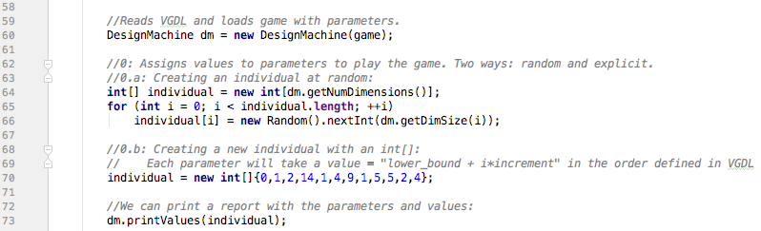
Parameterizing GVGAI
Running Game Spaces:
tracks.gameDesign.TestMultiGameSpace.java
Creating a game:
Example of int[] initialization:
‘2’ for values=0.1:0.1:1.0 -> 0.1 + 2*0.1 = 0.3

Slide 60
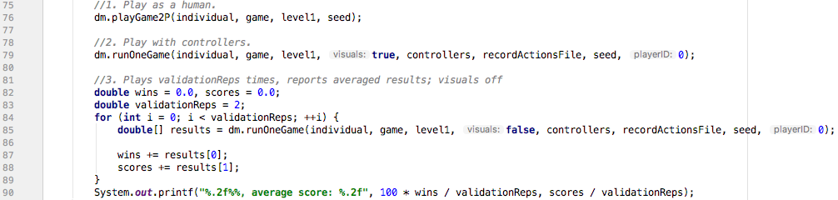
Parameterizing GVGAI
Running Game Spaces:
tracks.gameDesign.TestMultiGameSpace.java
Three execution modes:

Slide 61
Afternoon lab in groups
Download GVGAI Framework:
https://github.com/EssexUniversityMCTS/gvgai/archive/master.zip
The objective is to have a competitive and parameterizable 2-player game by the end of the day, with at least one level. You can
Design a new game from scratch; or
Take one of the existing games and make it parameterizable.
Note the following guidelines:
You must use the currently defined ontology.
There should be a clear and necessary interaction between both players.
We should expect that a more complex sample controller (OLMCTS, MCTS, GA) plays better than the simpler ones (OneStep, Random).

